Slide 1


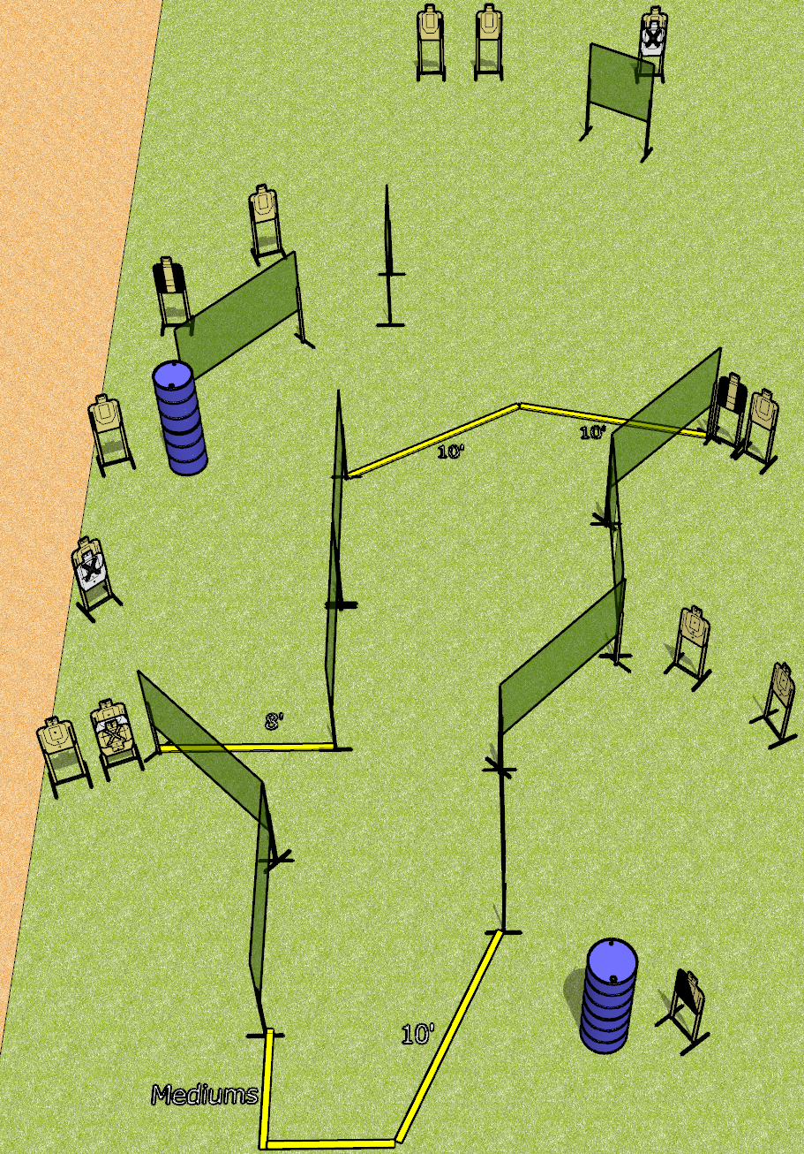
 | Dothan Gun Club – USPSA Match Run and Run Course Designer : Drew Coleman
Round Count 30 rounds 15 USPSA
Equipment List 16 wall feet 2 tux, 1 left diag, 15 targets (12 scoring + 3 NS)

Slide 2
Run and Run
Written Stage Briefing
Run and Run is a 30 round, 150 point, Comstock course of fire. There are 15 USPSA targets. The best 2 hits will score.
Handgun start position is anywhere completely outside the shooting area, wrists below belt. Handgun is loaded and holstered.
PCC start position is anywhere completely outside the shooting area, stock on belt. Loaded carbine is held with both hands, safety on.
On the audible start signal, engage targets as they become available from within the shooting area.

